Slide 1
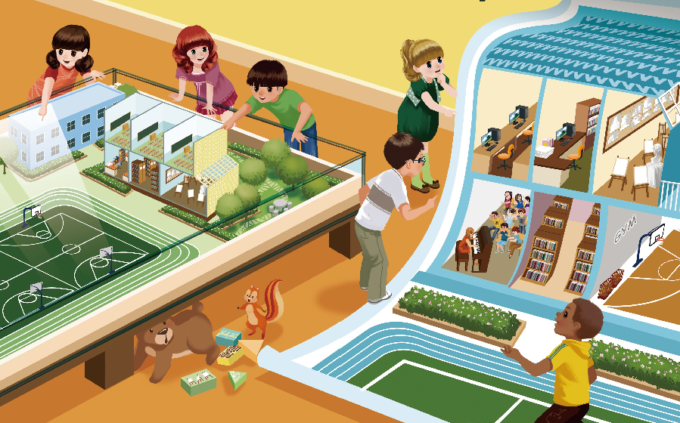
Unit1 My school
第4课时
B Let’s talk & Let’s play

Slide 2

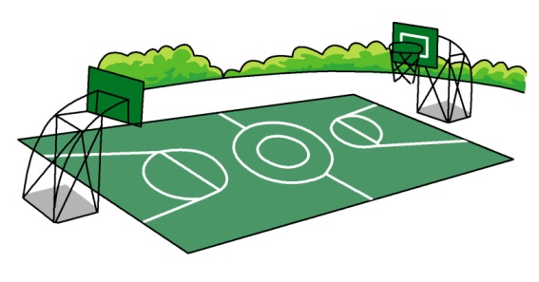
Review : Look and say. As quickly as you can.
（看得快，说得更快：看图，快速说单词。）

Slide 3


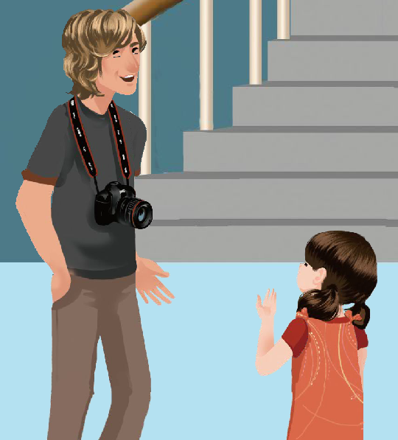
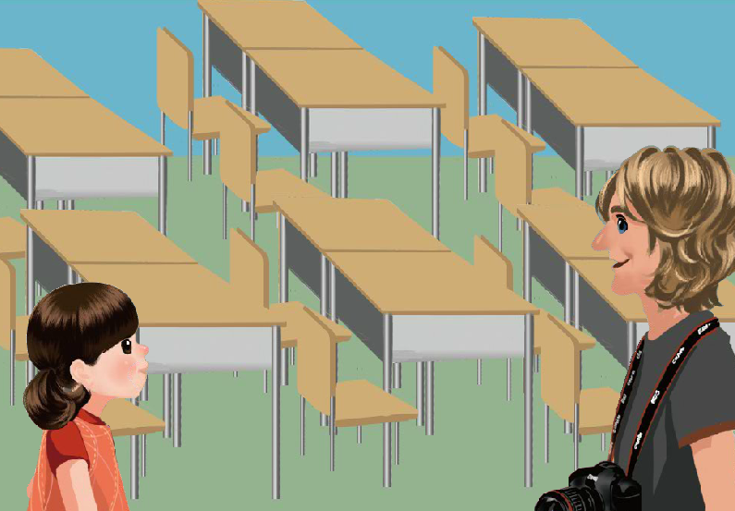

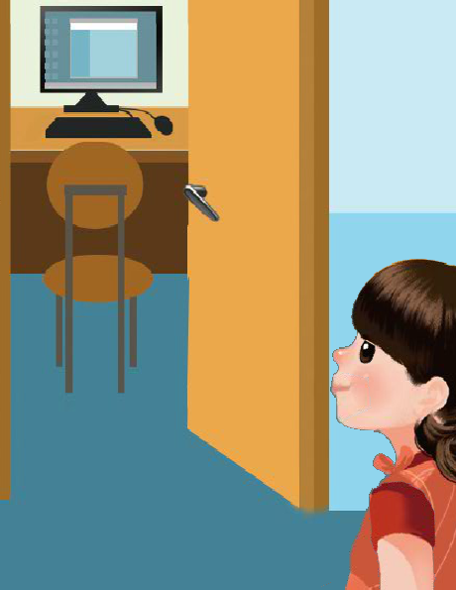
Watch and answer 听录音答题
1. How many students are there in Chen Jie’s class ?
2. Does Chen Jie have a library?
3. Is the library on the first floor?

Slide 4
Watch and answer 听录音答题解答
1. How many students are there in Chen Jie’s class ?
Forty-five students.
你答对了吗
2. Do you have a library?
Yes, we do.
3. Is the library on the first floor?
No, it isn’t. it’s on the second floor.

Slide 5
场景1：图中的Chen Jie怎么打招呼的？
It’s so big! How many students are there in your class?
Welcome to our school! This is my classroom.
Forty-five students.

Slide 6
场景2：他们在交谈什么？
Is that the computer room?
No, it isn’t. It’s the teacher’s office.

Slide 7
场景3：他们在交谈什么？
Do you have a library?
Yes, we do. It’s on the second floor. This way, please.

Slide 8
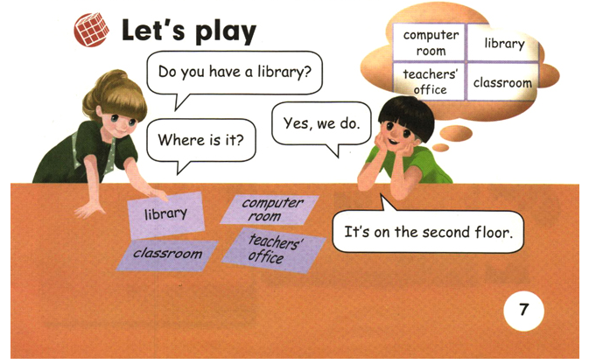
Let’s Play

Slide 9

Role playing
1. 看书能表演出来。OK!
2. 不看书，声音响亮、发音正确。Good!
3. 加上适当的动作表情和道具，
自然地表演出来。Super!

Slide 10
Make a survey
If you are a visitor，please make a survey.
小组活动，2个同学为一组，一位同学扮演参观者，询问其他同学，了解他们的学校建筑，并询问这些建筑的位置？

Slide 11
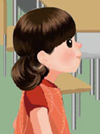

: Welcome to our school?
: Is that the…?
: Yes, it is. /No, it isn’t.
: do you have …?
: Yes, we do. It’s on the…floor.

Slide 12
Homework
☆:一星级:听录音，仿读对话；
☆☆:二星级:表演对话；
☆☆☆:三星级:和你的朋友一起根据对话内容创编新对话。
(你可以根据自己的实际情况任选一个做)

